Slide 1
Ethernet
Outline
Multiple Access and Ethernet Intro
Ethernet Framing
CSMA/CD protocol
Exponential backoff

Slide 2
Shared Access Networks are Different
Shared Access Networks assume multiple nodes on the same physical link
Bus, ring and wireless structures
Transmission sent by one node is received by all others
No intermediate switches
Need methods for moderating access (MAC protocols)
Fairness
Performance
How can this be done?

Slide 3
Multiple Access Methods
Fixed assignment
Partition channel so each node gets a slice of the bandwidth
Essentially circuit switching – thus inefficient
Examples: TDMA, FDMA, CDMA (all used in wireless/cellular environments)
Contention-based
Nodes contends equally for bandwidth and recover from collisions
Examples: Aloha, Ethernet
Token-based or reservation-based
Take turns using the channel
Examples: Token ring

Slide 4
A Quick Word about Token Ring
Developed by IBM in early 80’s as a new LAN architecture
Consists of nodes connected into a ring (typically via concentrators)
Special message called a token is passed around the ring
When nodes gets the token it can transmit for a limited time
Every node gets an equal opportunity to send
IEEE 802.5 standard for Token Ring
Designed for predictability, fairness and reliability
Originally designed to run at either 4Mbps and 16Mbps
Still used and sold but beaten out by Ethernet

Slide 5
Our Focus is Ethernet
History
Developed by Bob Metcalfe and others at Xerox PARC in mid-1970s
Roots in Aloha packet-radio network
Standardized by Xerox, DEC, and Intel in 1978
LAN standards define MAC and physical layer connectivity
IEEE 802.3 (CSMA/CD - Ethernet) standard – originally 2Mbps
IEEE 802.3u standard for 100Mbps Ethernet
IEEE 802.3z standard for 1,000Mbps Ethernet
CSMA/CD: Ethernet’s Media Access Control (MAC) policy
CS = carrier sense
Send only if medium is idle
MA = multiple access
CD = collision detection
Stop sending immediately if collision is detected

Slide 6
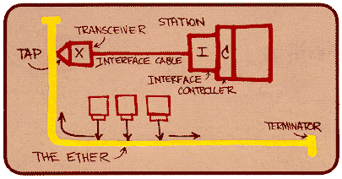
Ethernet Standard Defines Physical Layer
802.3 standard defines both MAC and physical layer details
Metcalfe’s original
Ethernet Sketch

Slide 7
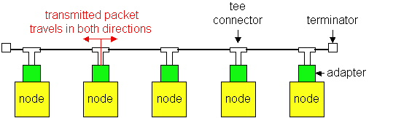
Ethernet Technologies: 10Base2
10: 10Mbps; 2: under 185 (~200) meters cable length
Thin coaxial cable in a bus topology
Repeaters used to connect multiple segments
Repeater repeats bits it hears on one interface to its other interfaces: physical layer device only!

Slide 8
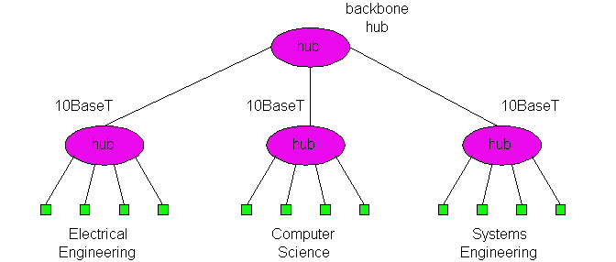
10BaseT and 100BaseT
10/100 Mbps rate
T stands for Twisted Pair
Hub(s) connected by twisted pair facilitate “star topology”
Distance of any node to hub must be < 100M

Slide 9
Physical Layer Configurations for 802.3
Physical layer configurations are specified in three parts
Data rate (10, 100, 1,000)
10, 100, 1,000Mbps
Signaling method (base, broad)
Baseband
Digital signaling
Broadband
Analog signaling
Cabling (2, 5, T, F, S, L)
5 - Thick coax (original Ethernet cabling)
F – Optical fiber
S – Short wave laser over multimode fiber
L – Long wave laser over single mode fiber

Slide 10
Ethernet Overview
Most popular packet-switched LAN technology
Bandwidths: 10Mbps, 100Mbps, 1Gbps
Max bus length: 2500m
500m segments with 4 repeaters
Bus and Star topologies are used to connect hosts
Hosts attach to network via Ethernet transceiver or hub or switch
Detects line state and sends/receives signals
Hubs are used to facilitate shared connections
All hosts on an Ethernet are competing for access to the medium
Switches break this model
Problem: Distributed algorithm that provides fair access

Slide 11
Ethernet Overview (contd.)
Ethernet by definition is a broadcast protocol
Any signal can be received by all hosts
Switching enables individual hosts to communicate
Network layer packets are transmitted over an Ethernet by encapsulating
Frame Format
64
48
48
16
32
Preamble
Dest
Src
Type
Body
CRC
addr
addr

Slide 12
Switched Ethernet
Switches forward and filter frames based on LAN addresses
It’s not a bus or a router (although simple forwarding tables are maintained)
Very scalable
Options for many interfaces
Full duplex operation (send/receive frames simultaneously)
Connect two or more “segments” by copying data frames between them
Switches only copy data when needed
key difference from repeaters
Higher link bandwidth
Collisions are completely avoided
Much greater aggregate bandwidth
Separate segments can send at once

Slide 13
Ethernet Frames
Preamble is a sequence of 7 bytes, each set to “10101010”
Used to synchronize receiver before actual data is sent
Addresses
unique, 48-bit unicast address assigned to each adapter
example: 8:0:e4:b1:2
Each manufacturer gets their own address range
broadcast: all 1s
multicast: first bit is 1
Type field is a demultiplexing key used to determine which higher level protocol the frame should be delivered to
Body can contain up to 1500 bytes of data

Slide 14
A Quick Word about Aloha Networks
Developed in late 60’s by Norm Abramson at Univ. of Hawaii (!!) for use with packet radio systems
Any station can send data at any time
Receiver sends an ACK for data
Timeout for ACK signals that there was a collision
What happens if timeout is poorly timed?
If there is a collision, sender will resend data after a random backoff
Utilization (fraction of transmitted frames avoiding collision for N nodes) was pretty bad
Max utilization = 18%
Slotted Aloha (dividing transmit time into windows) helped
Max utilization increased to 36%

Slide 15
Ethernet’s MAC Algorithm
Ethernet uses CSMA/CD – listens to line before/during sending
If line is idle (no carrier sensed)
send packet immediately
upper bound message size of 1500 bytes
must wait 9.6us between back-to-back frames
If line is busy (carrier sensed)
wait until idle and transmit packet immediately
called 1-persistent sending
If collision detected
Stop sending and jam signal
Try again later

Slide 16
State Diagram for CSMA/CD
Packet?
No
Sense Carrier
Send
Detect Collision
Yes
Discard Packet
Jam channel b=CalcBackoff(); wait(b);
attempts++;
attempts < 16
attempts == 16

Slide 17
Collisions
Collisions are caused when two adaptors transmit at the same
time (adaptors sense collision based on voltage differences)
Both found line to be idle
Both had been waiting to for a busy line to become idle
A starts at
time 0
A
B
Message almost
there at time T when
B starts – collision!
A
B
How can we be sure A knows about the collision?

Slide 18
Collision Detection
How can A know that a collision has taken place?
There must be a mechanism to insure retransmission on collision
A’s message reaches B at time T
B’s message reaches A at time 2T
So, A must still be transmitting at 2T
IEEE 802.3 specifies max value of 2T to be 51.2us
This relates to maximum distance of 2500m between hosts
At 10Mbps it takes 0.1us to transmit one bit so 512 bits (64B) take 51.2us to send
So, Ethernet frames must be at least 64B long
14B header, 46B data, 4B CRC
Padding is used if data is less than 46B
Send jamming signal after collision is detected to insure all hosts see collision
48 bit signal

Slide 19
Collision Detection contd.
time = 0
A
B
A
B
time = T
A
B
time = 2T

Slide 20
Exponential Backoff
If a collision is detected, delay and try again
Delay time is selected using binary exponential backoff
1st time: choose K from {0,1} then delay = K * 51.2us
2nd time: choose K from {0,1,2,3} then delay = K * 51.2us
nth time: delay = K x 51.2us, for K=0..2^{n} – 1
Note max value for k = 1023
give up after several tries (usually 16)
Report transmit error to host
If delay were not random, then there is a chance that sources would retransmit in lock step
Why not just choose from small set for K
This works fine for a small number of hosts
Large number of nodes would result in more collisions

Slide 21
MAC Algorithm from the Receiver Side
Senders handle all access control
Receivers simply read frames with acceptable address
Address to host
Address to broadcast
Address to multicast to which host belongs
All frames if host is in promiscuous mode

Slide 22
Fast and Gigabit Ethernet
Fast Ethernet (100Mbps) has technology very similar to 10Mbps Ethernet
Uses different physical layer encoding (4B5B)
Many NIC’s are 10/100 capable
Can be used at either speed
Gigabit Ethernet (1,000Mbps)
Compatible with lower speeds
Uses standard framing and CSMA/CD algorithm
Distances are severely limited
Typically used for backbones and inter-router connectivity
Becoming cost competitive
How much of this bandwidth is realizable?
Long haul Ethernet
40GB,100GB

Slide 23
Experiences with Ethernet
Ethernets work best under light loads
Utilization over 30% is considered heavy
Network capacity is wasted by collisions
Most networks are limited to about 200 hosts
Specification allows for up to 1024
Most networks are much shorter
5 to 10 microsecond RTT
Transport level flow control helps reduce load (number of back to back packets)
Ethernet is inexpensive, fast and easy to administer!

Slide 24
Ethernet Problems
Ethernet’s peak utilization is pretty low (like Aloha)
Peak throughput worst with
More hosts
More collisions needed to identify single sender
Smaller packet sizes
More frequent arbitration
Longer links
Collisions take longer to observe, more wasted bandwidth
Efficiency is improved by avoiding these conditions

Slide 25
Why did Ethernet Win?
There are LOTS of LAN protocols
Price
Performance
Availability
Ease of use
Scalability
Tomorrow we will talk about physical layer stuff…

